Slide 1
Gunpowder River Woody Debris
Comments by the Paddling Community

Slide 2
GBCC Statement
The GBCC thanks the Department of Natural Resources for hosting this meeting to discuss woody debris in the River. GBCC is a Maryland paddling club and our 200 households enjoy frequent use of the Gunpowder system for recreational paddling. While we are paddlers, GBCC recognizes that the Park is a treasure valued by diverse groups of users and supports the Park being managed to maximize safe usage by all groups.
Given that the Gunpowder receives a regulated flow of water from Prettyboy Dam, woody debris is not deposited and cleared by naturally occurring variances in water level. Man regulates the water flow, and man may need to intervene in other ways to manage the resource.
Strainers are a major hazard, especially to tubers and naïve boaters, who constitute the majority of boating users. Nationwide, naïve boaters acting out of ignorance account for a significant percentage of river fatalities. Experienced GBCC members have performed countless minor rescues and a couple that probably would have resulted in fatalities had expertise not been there.
GBCC understands and agrees that woody debris is ecologically important. However, when woody debris becomes a dangerous strainer, GBCC believes the strainer should be neutralized. This does not mean complete removal, but cutting or repositioning to reduce the potential of the strainer trapping a victim.
While willing to help, as it does with other projects at Gunpowder State Park, GBCC understands the Park’s policy is that woodcutting is only done by Park personnel. We respect this policy and encourage the Park to promptly mitigate hazardous strainers. GBCC members will assist by communicating to the Park the location of dangerous strainers.
Notes:
Prettyboy acts as a buffer preventing clearing flows.
Hikers, photographers, birders, tubers, fishermen and paddlers are a sampling of the many stakeholders of the general public.
The state is responsible for managing the resource for stakeholders.
Tubers are mostly a group lacking in experience and training. Many paddlers are also lacking in experience and training. Few understand the risks and are ill prepared. How many wear flip flops as footwear? How many do not wear a PFD?
How may fishermen wear a PFD? How many fisherman have tried to float through a strainer.

Slide 3
Assumptions
Maintaining the biodiversity of the aquatic and riparian zones is of great importance.
The management area is between Prettyboy Dam and Big Falls Rd.
The management area is not subject to natural regulation.
There are many stakeholders.
Most tubers and paddlers are Novices.
Many fishermen do not recognize the hazard.
Notes:
Prettyboy acts as a buffer preventing clearing flows.
Hikers, photographers, birders, tubers, fishermen and paddlers are a sampling of the many stakeholders of the general public.
The state is responsible for managing the resource for stakeholders.
Tubers are mostly a group lacking in experience and training. Many paddlers are also lacking in experience and training. Few understand the risks and are ill prepared. How many wear flip flops as footwear? How many do not wear a PFD?
How may fishermen wear a PFD? How many fisherman have tried to float through a strainer.

Slide 4
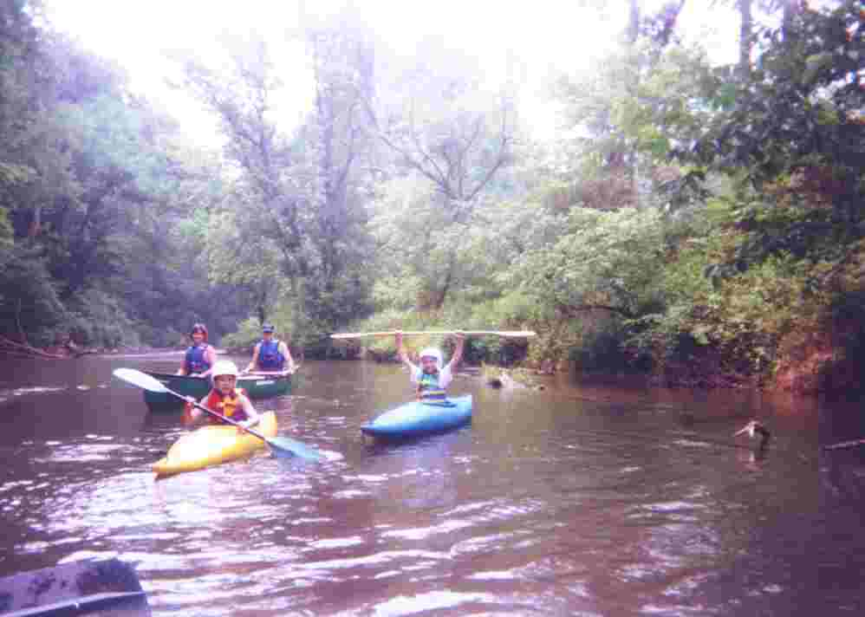
Novice Paddlers

Slide 5
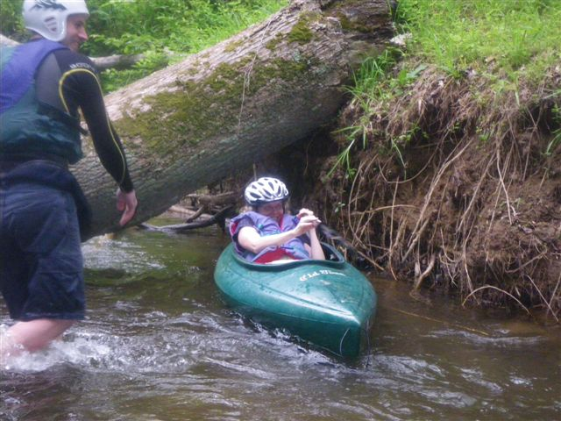
Enjoying a Limbo Log

Slide 6
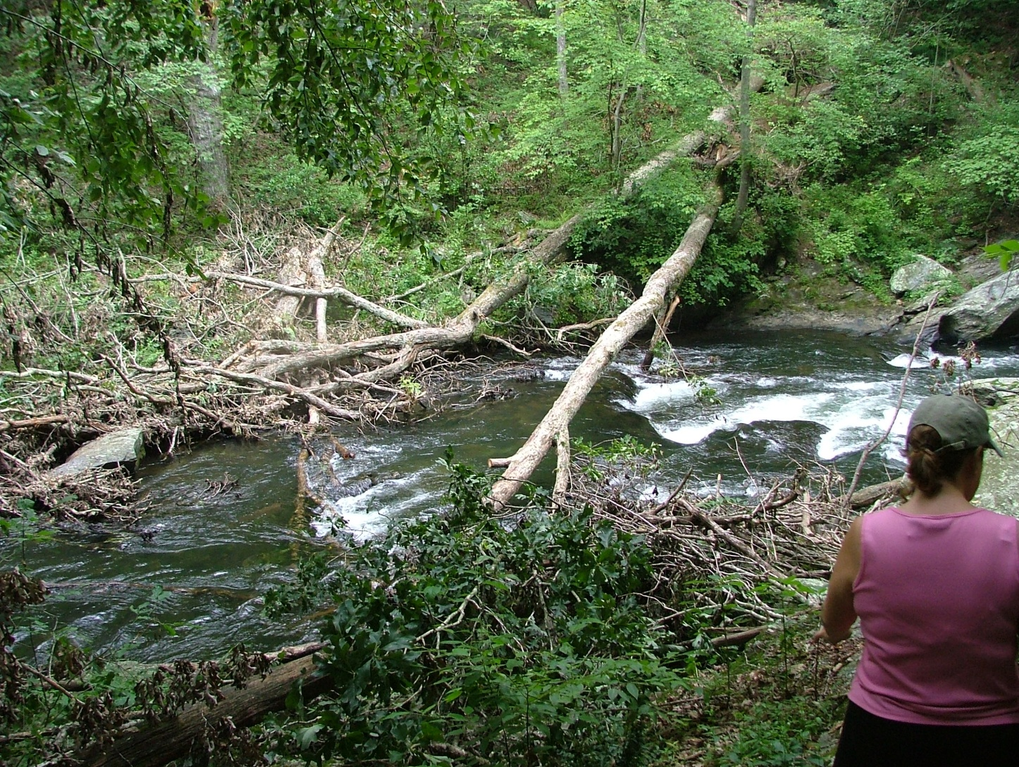
Fun for Experienced Paddlers
Dangerous for Novice Paddlers

Slide 7
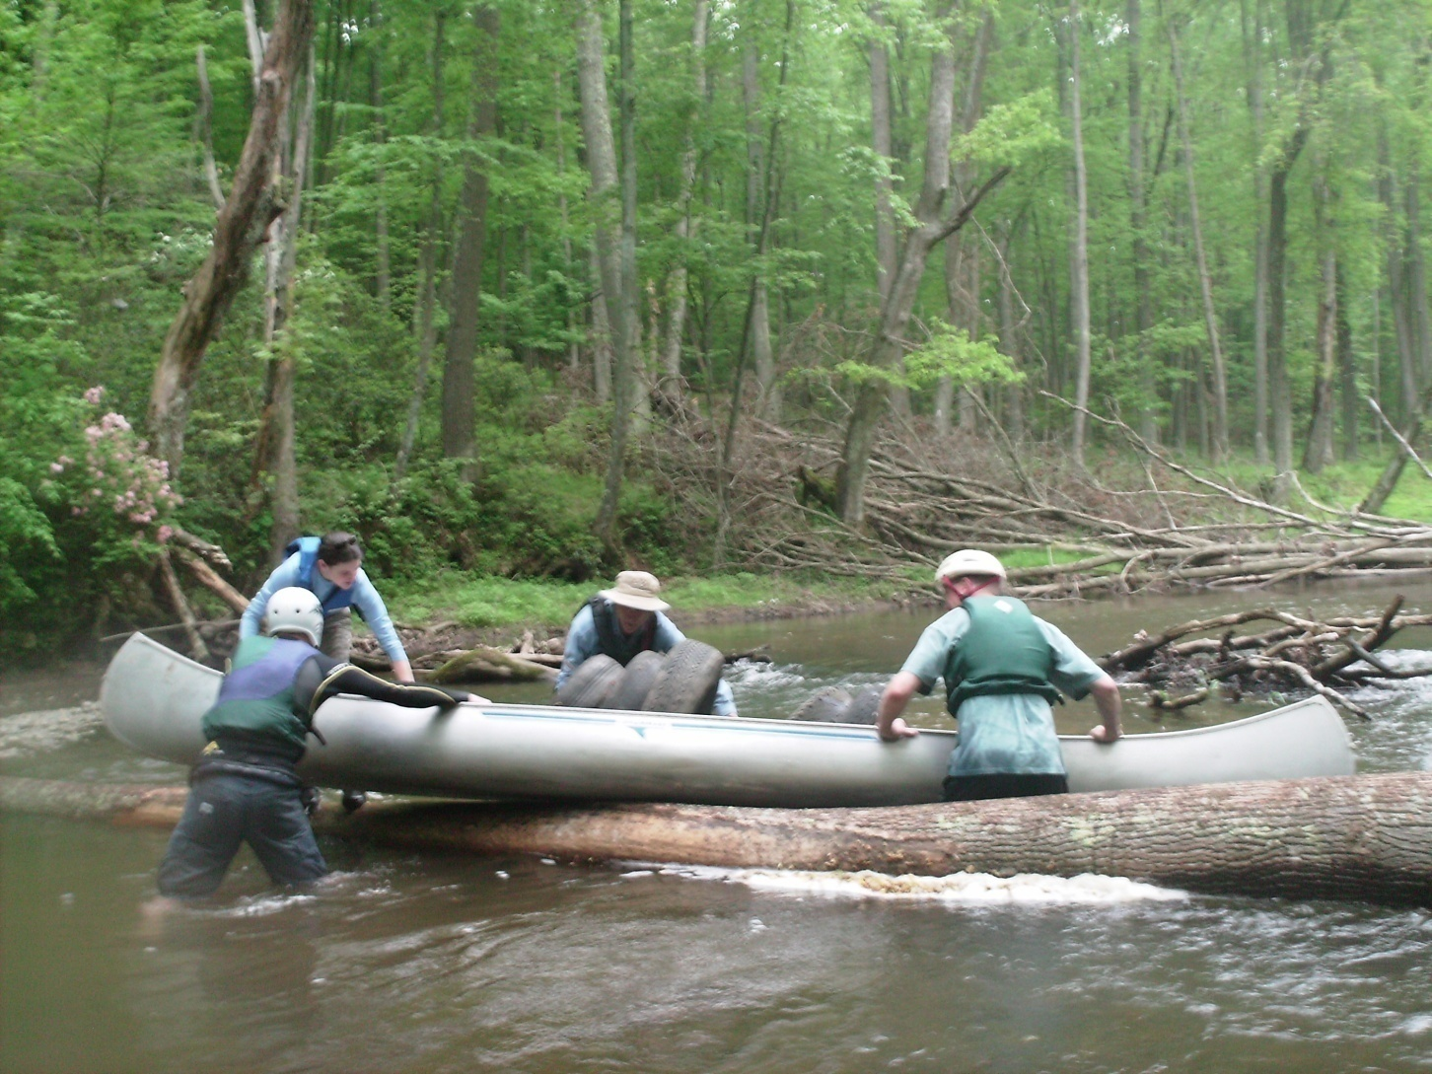
Mid River Portage

Slide 8
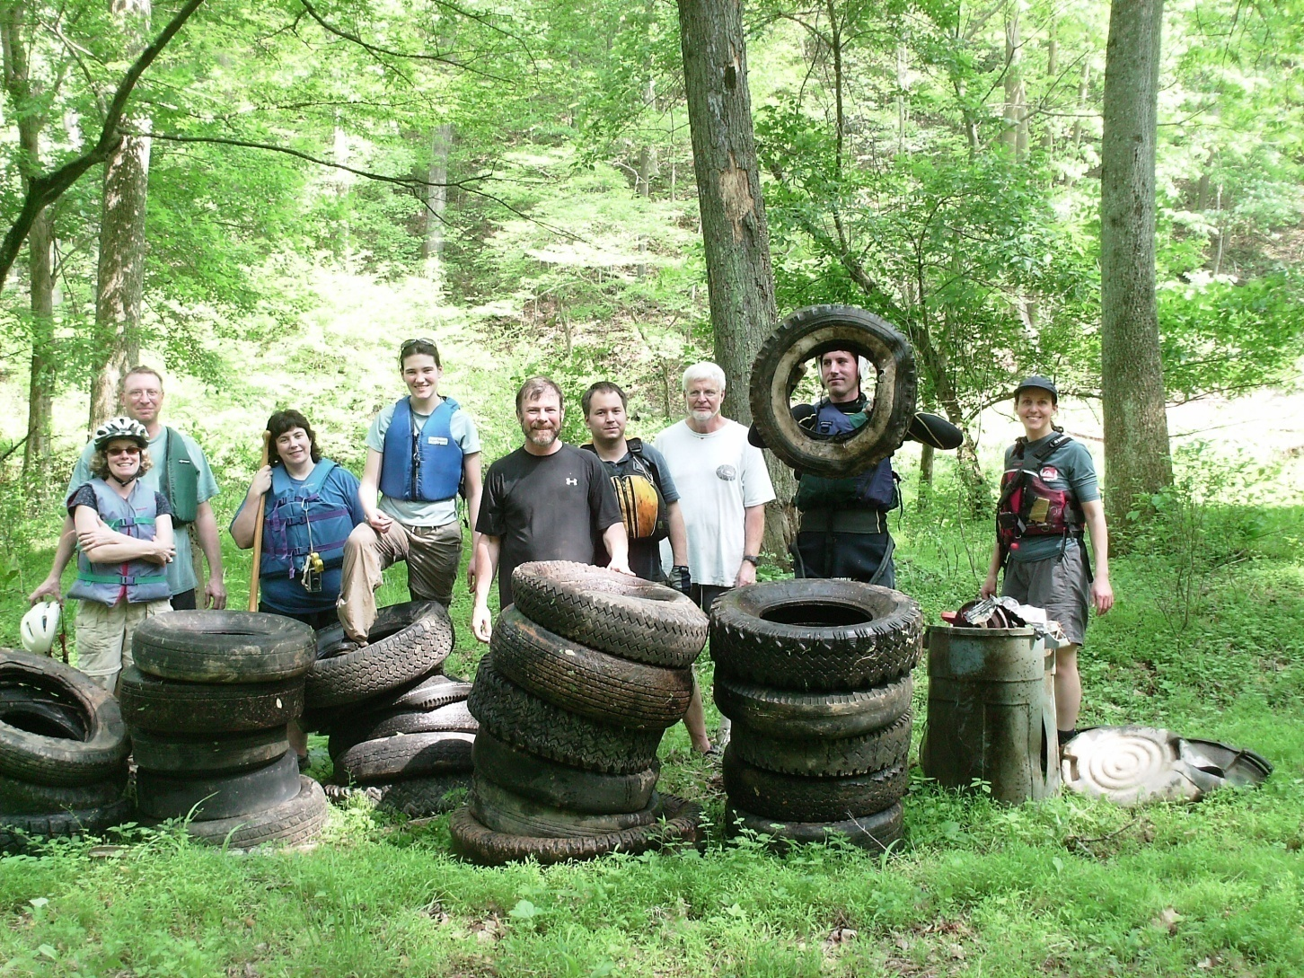
Tire Run 2009

Slide 9
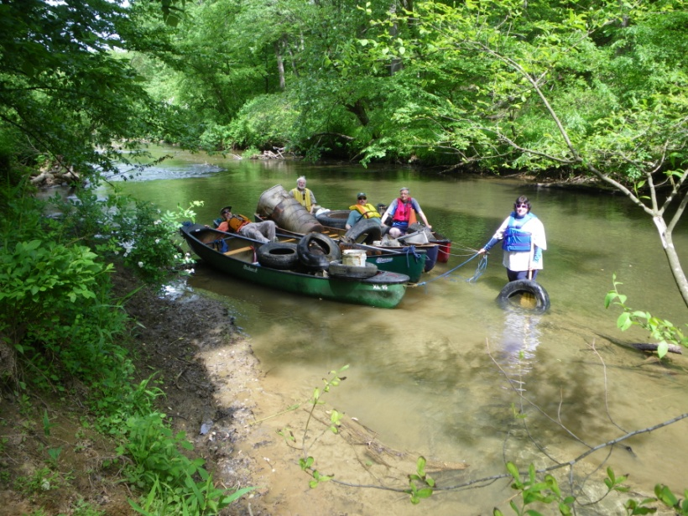
Tire Run 2010

Slide 10
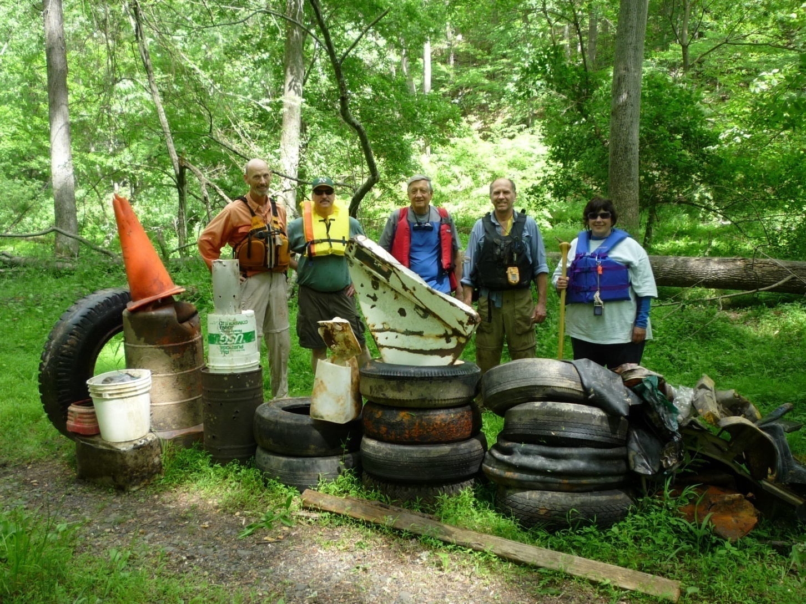
Tire Run 2010

Slide 11
Objectives
Conserve these habitats and resources.
Improve the fishery habitat
Improve the resource for all stakeholders
Mitigate Risk to Humans.
Maintain the canoe trail.
Notes:
Club members have, on at least three instances, rescued tubers or inexperienced paddlers caught up in strainers.
For experienced and trained paddlers, limbo logs, bump logs and dusters are part of the adventure and fun. To the inexperienced, these are life threatening.

Slide 12
Proposal
Creation of a policy the simulates the natural process.
Develop a policy that satisfies the needs of stakeholders.
Develop a trust relationship between the stakeholders.
Reposition only the wood that poses a threat to life.
Notes:
Recognize that woody debris does not stay in one place for years because high flow periods reposition it.
Recognize that there are many stakeholders and the state needs to balance the needs of the stake holders.
Recognize that stakeholders are concerned organizations and want to improve the resource, not destroy it.
Move wood that poses a threat to life to the side.

Slide 13
Greater Baltimore Canoe Club
Canoers and Kayakers
Novices and highly skilled
Educators and Students
Conservationists
  Twice improved the trail at Jones Rd
    Funding provided by multiple organizations
  Since 2005, held several Tire Runs
    Removed almost 100 tires
Notes:
GBCC members take novices and turn them into skilled paddlers through Roll Session Clinics and White Water Clinics and Swift Water Rescue Clinics.
There have been two access trail improvement projects with a third scheduled for Jones Rd in April 2011
Tire Runs remove tires from the river, riparian and surrounding areas of the GP Park. They have also identified two illegal dumps. One was cleaned up and the second is in progress.
2005 47 tires
2006 7 tires
2008 working with MDE 500-1000 tires
2009 29 tires
2010 15 tires
Once notified of a hazard, if action is not taken, what and who has the liability if any?
How quickly can a hazard be assessed and the appropriate action taken?
Who should be contacted?
What is the process in an emergency?
How Can Paddlers Help?

Slide 14
Contact Information
www.baltimorecanoeclub.org
or
Charles Hihn
18426 Gunpowder Rd
Hampstead, MD 21074
buddyh@hiventures.com
410-374-4164
Notes:
2005 46 tires
2006 7 tires
2007 0 Park personnel change and could not handle the load
2008 Working with MDE had approx 1000 tires removed from illegal dump.
2009 29 tires and numerous other items.
2010 15 tires over 40 tires from the LGP
Once notified of a hazard, if action is not taken, what and who has the liability if any?
How quickly can a hazard be assessed and the appropriate action taken?
Who should be contacted?
What is the process in an emergency?
How Can Paddlers Help?

